Slide 1

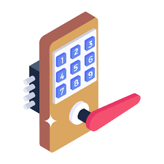
IOT Based Digital Keypad Door Lock System
Guided by:
Prof. MANJUNATH. G

Slide 2


TABLE OF CONTENT
Abstract
Introduction
Problem Statement
Tools Required
Proposed Methodology
Implementation
Advantages
Applications
Conclusion
Demonstration

Slide 3


ABSTRACT
The main objective of the mini project is to design a digital/smart door lock system that can modernize door locks.
Smart door lock can help smoothen the door unlocking process.
Smart door lock can guarantee more security than standard door locks and increase general safety of society

Slide 4


INTRODUCTION
MOTIVATION
In today’s world, home safety is a major concern due to the increase in population as well as steep increase in crime rate.
The need for a more modern, secure and revolutionized door locking system arises as the standard of living as well as security concerns of citizens increases
To meet and match these needs, designing a smart door lock that can satisfy the needs and concerns of today’s world is necessary

Slide 5


PROBLEM STATEMENT
Security Risks
Authentication vs. Convenience
Battery Life
Integration Issues
Accessibility
Durability
Emergency Access
Cost vs. Performance

Slide 6
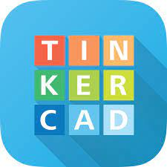
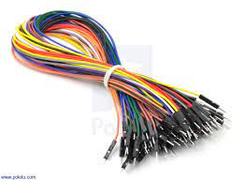
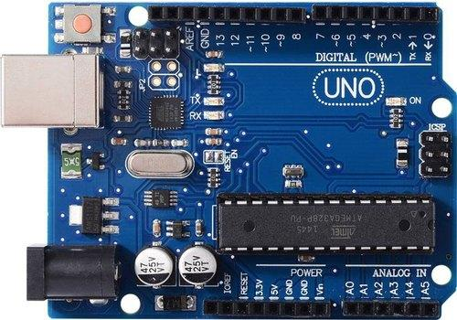
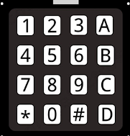
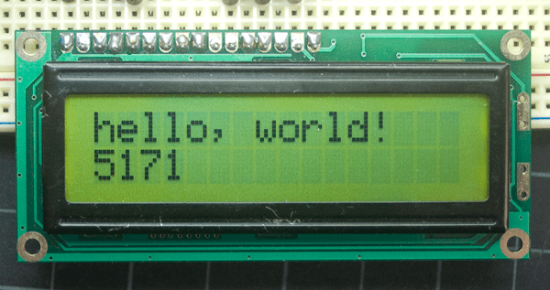
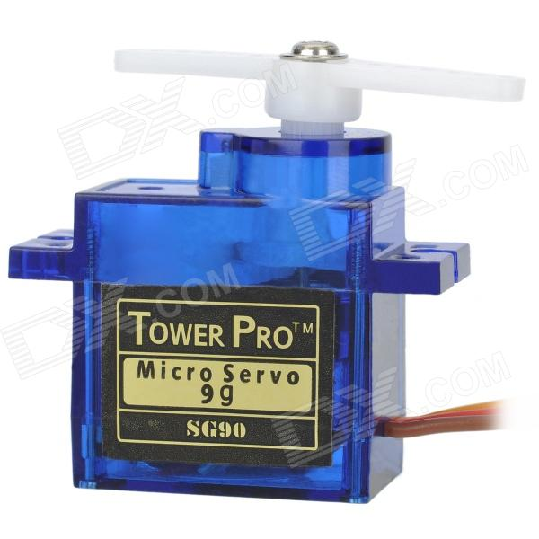
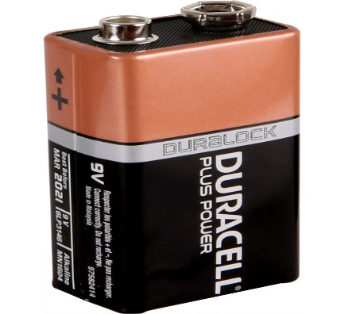
TOOLS AND LANGUAGES REQUIRED
Simulation Tool
Arduino UNO
Jumper Wire
Jumper Wire
Arduino UNO
Tools&Language
LCD
Tower Pro SG90 Servomotor
LCD
9V Battery
Tower Pro SG90 Servomotor
9V Battery

Slide 7
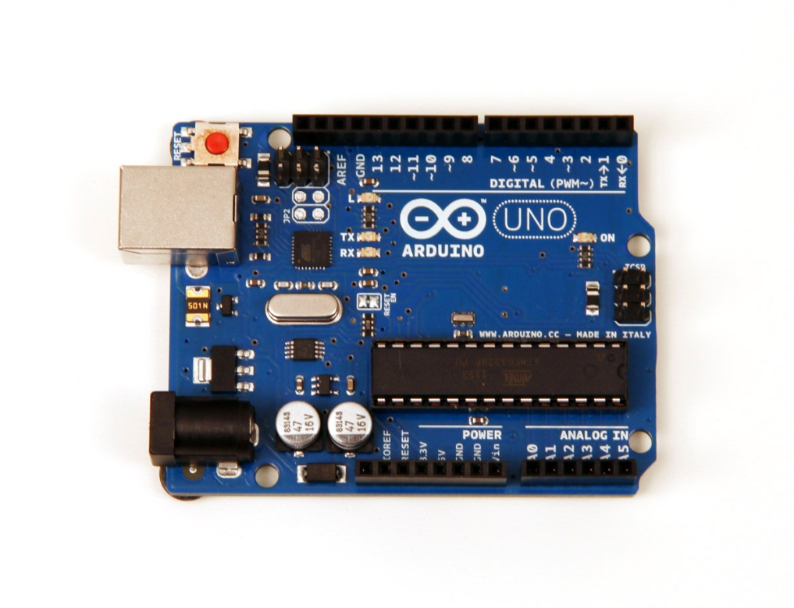
PROPOSED METHODOLOGY
BLOCK DIAGRAM
DIGITAL
KEYPAD
MOTOR
(100 RPM
SERVO
MOTOR
ATMEGA 328P
LCD
POWER
SUPPLY

Slide 8





HOW IT WORKS

Slide 9
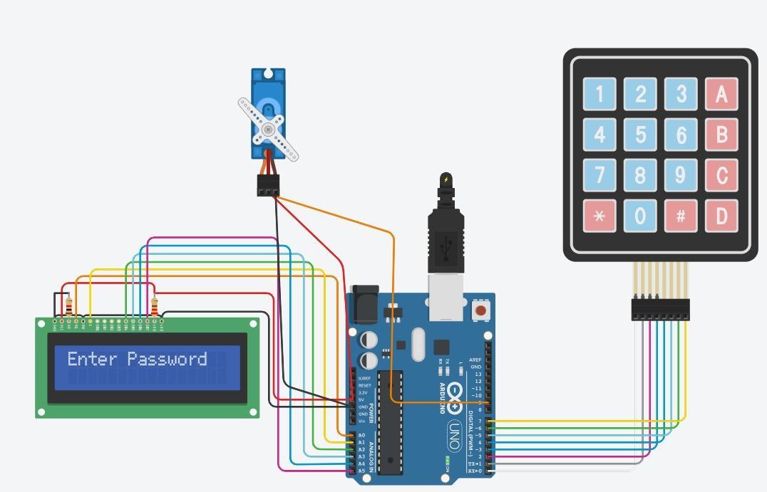
IMPLEMENTATION

Slide 10
D
E
S
I
G
N
F
L
O
W
Start
Predefined Password
Reset
Keypad Input
Servo Motor ON
Check Password
Turn On LCD

Slide 11
ADVANTAGES
Convenience: Smart door locks allow remote operation via a smartphone app, enabling you to lock or unlock your door from anywhere.
Enhanced Security: They offer advanced security features like encrypted communication, keyless entry, and real-time tamper alerts.
Keyless Entry: Smart locks eliminate the need for physical keys, offering entry through keypads, biometrics, or smartphone apps.
Integration with Smart Home Systems: They can integrate with other smart home devices for a unified home automation experience.
Audit Trails and Notifications: Smart locks provide activity logs and real-time notifications about who enters or exits your home.
.

Slide 12


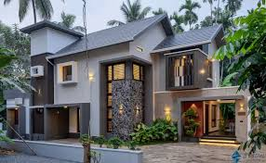
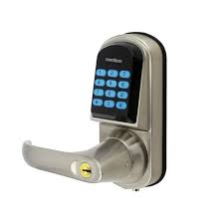


APPLICATIONS
College
Household
Schools
APPLICATIONS
Apartments
Hospitals

Slide 13

CONCLUSION
In conclusion, the IoT-based digital keypad door lock system significantly enhances security through advanced technology and real-time connectivity. It provides users with the convenience of remote access management and detailed activity logs. The integration of IoT allows for seamless interaction with other smart home devices, elevating overall security and ease of use. As technology progresses, this system is well-positioned to offer even more innovative solutions for modern security needs.
This Photo by Unknown author is licensed under CC BY-SA.
This Photo by Unknown author is licensed under CC BY.

Slide 14
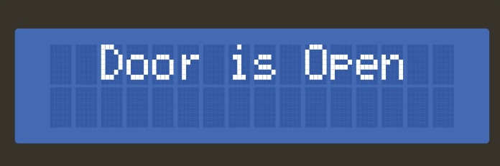
SIMULATION RESULT 1

Slide 15
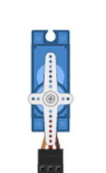
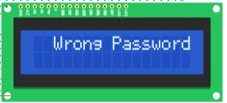
SIMULATION RESULT 2

Slide 16
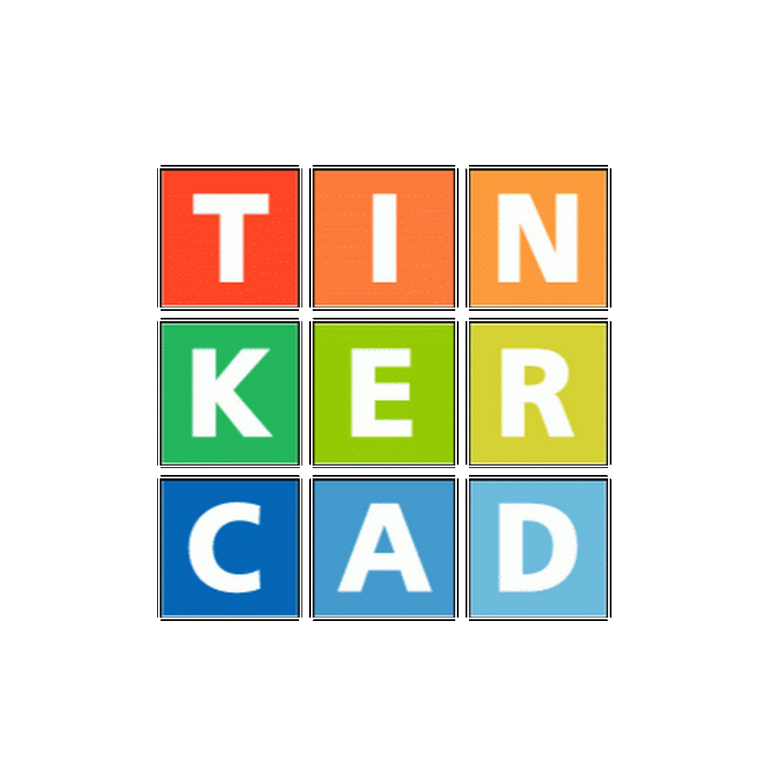
DEMONSTRATION USING TINKER CAD

Slide 17
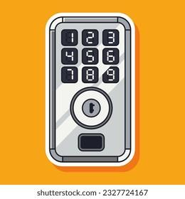
THANK YOU

Slide 18
QUERIES????

